Slide 1
Timepiece Trends: A Deep Dive into Watch Characteristics and Market Dynamics
Haritha Kothuru
AF0366846

Slide 2
Abstract
▶ The project aims to analyze a comprehensive dataset of watches, focusing on various attributes such as brand, materials, movement types, pricing, and features. Through exploratory data analysis and visualization techniques, the project delves into the trends, preferences, and correlations within the watch market. The findings provide valuable insights for watch enthusiasts, manufacturers, and retailers in understanding consumer preferences and market dynamics.

Slide 3
Software Requirements
▶ Python (version 3.0 or higher)
▶ Pandas library for data manipulation
▶ Matplotlib and Seaborn libraries for data visualization
▶ Jupyter Notebook or any Python IDE for code execution and analysis
▶ SQL for data extraction and manipulation

Slide 4
Advantages
▶ Brand Popularity Insights: The analysis provides a clear view of which watch
brands are popular based on the count of watches and their average prices.
▶ Material Preferences: By analyzing case materials, strap materials, and crystal materials, the project reveals trends in material preferences among consumers.
▶ Pricing Strategies: The project explores average prices by water resistance, case material, and movement type, helping stakeholders understand pricing strategies and market positioning.

Slide 5
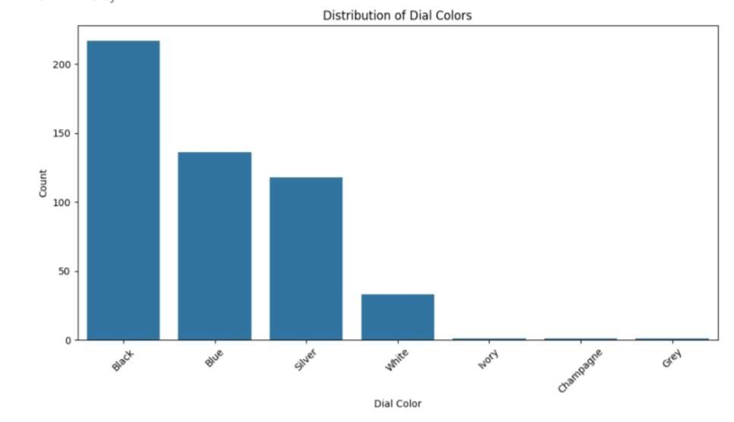
Distribution of dial colors?

Slide 6
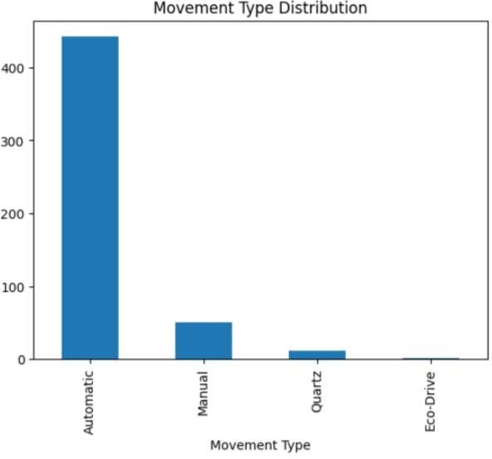
Movement type distribution?

Slide 7
Gantt Chart
Software Development Life Cycle | MARCH 2024
 | 1 | 2 | 3 | 4 | 5 | 6 | 7 | 8 | 9 | 10 | 11 | 12 | 13 | 14 | 15
Project Planning
Gather Requirements
Designing project
Implementation
Testing
Deployment
Maintenance

Slide 8
Future Enhancements
▶ Incorporate machine learning models for predictive analysis, such as price
prediction based on watch characteristics.
▶ Include sentiment analysis of customer reviews to gauge customer satisfaction
and product perception.
▶ Explore additional datasets to enrich the analysis, such as sales data,
customer demographics, and market trends.

Slide 9
Conclusion
▶ The project showcases a comprehensive analysis of watch data, highlighting key insights into brand popularity, material preferences, pricing strategies, and feature trends. Through visualizations and statistical summaries, the project provides actionable insights for stakeholders in the watch industry to make informed decisions and capitalize on emerging market trends. Further enhancements and advanced analytics can enhance the project’s scope and utility in understanding and navigating the dynamic watch market landscape.

Slide 10
Thank You

